Slide 1
Basics of Machine Learning

Slide 2
Machine Learning
Machine learning is an application of artificial intelligence (AI) that provides systems the ability to automatically learn and improve from experience without being explicitly programmed
The primary aim is to allow the computers learn automatically without human intervention or assistance and adjust actions accordingly

Slide 3
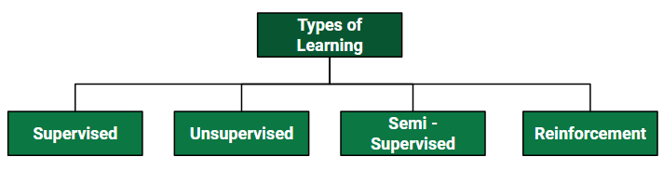
Types of Machine Learning
There are 4 types of Machine Learning Algorithms

Slide 4
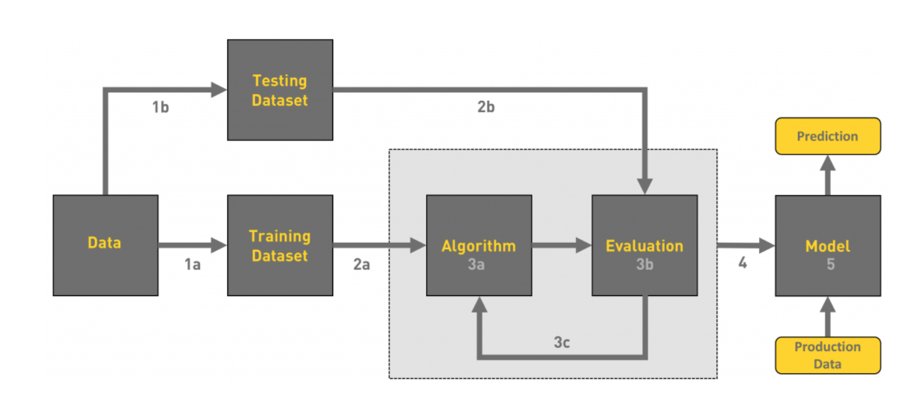
Machine Learning Workflow

Slide 5
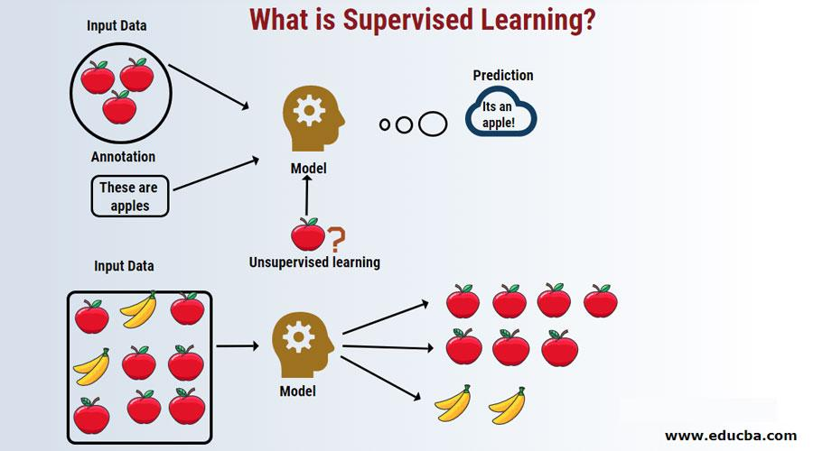
Supervised Machine Learning
Supervised learning is when model gets trained on Labelled Dataset. Labelled Dataset is one which have both input and output parameters
Types of Supervised Machine Learning
Classification
Regression
Examples of Supervised Machine Learning Algorithms
Linear Regression
K-Nearest Neighbor
Gaussian Naive Bayes
Decision Tree
Support Vector Machine(SVM)
Random Forest

Slide 6
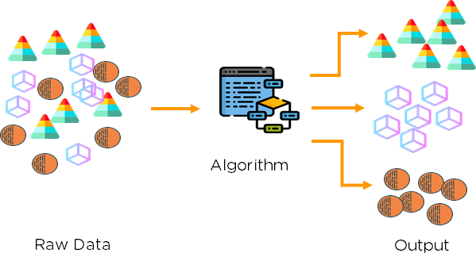
Unsupervised Machine Learning
Unsupervised machine learning algorithms infer patterns from a dataset without reference to known, or labeled, outcomes
Unlike supervised machine learning, unsupervised machine learning methods cannot be directly applied to a regression a classification problem
Unsupervised learning can instead be used for discovering the underlying structure of the data
Examples of UnSupervised Machine Learning Algorithms
K Means Clustering, DBSCAN, ID3
PCA, SVD

Slide 7
Semi Supervised Machine Learning
Semi-supervised machine learning is a combination of supervised and unsupervised machine learning methods.
Train a machine learning algorithm on a “labeled” dataset in which each record includes the outcome information
This allows the algorithm to deduce patterns and identify relationships between your target variable and the rest of the dataset based on information it already has
In semi-supervised learning, an algorithm learns from a dataset that includes both labeled and unlabeled data, usually mostly unlabeled.

Slide 8
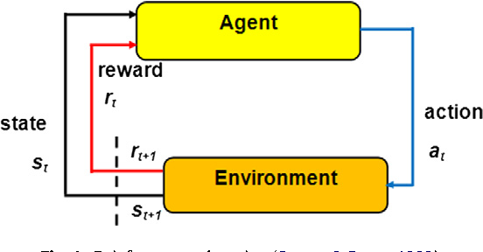
Reinforcement Machine Learning
The Idea behind the Reinforcement learning is that an agent will learn from the environment by interacting with it and receiving rewards for performing an action

Slide 9
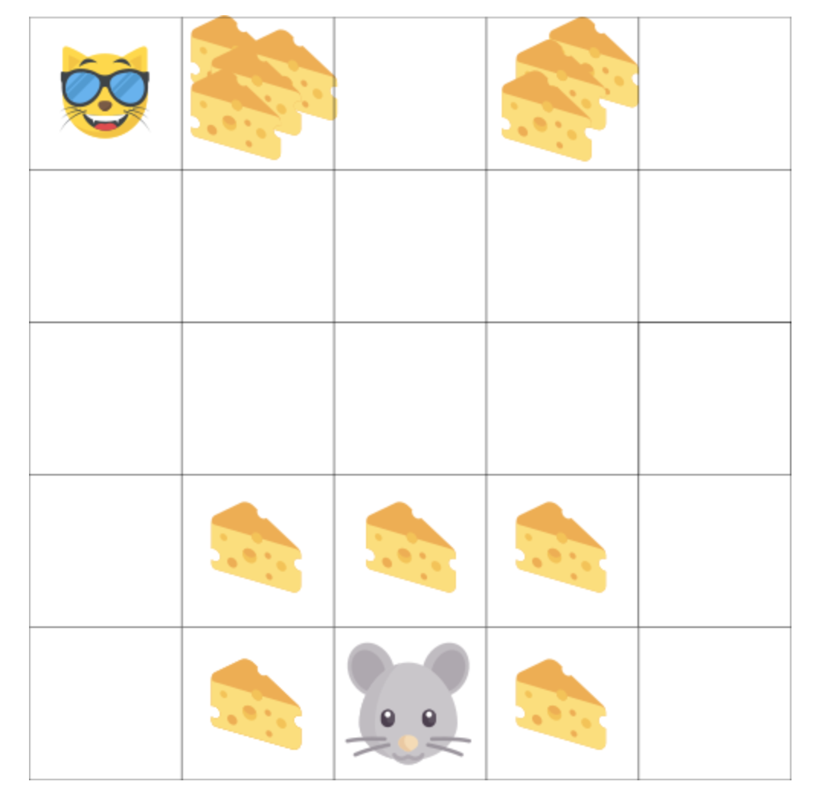
Reinforcement Learning Process
Let’s Say Your Agent is the small mouse and your opponent is a cat.
Your goal is to eat maximum amount of the cheese before being eaten by the cat
As we can see in the Diagram, it’s more probable to eat the cheese near us than the cheese close to the cat.
As a Consequence, the reward near the cat, even if it is bigger(more cheese), will be discounted.

Slide 10
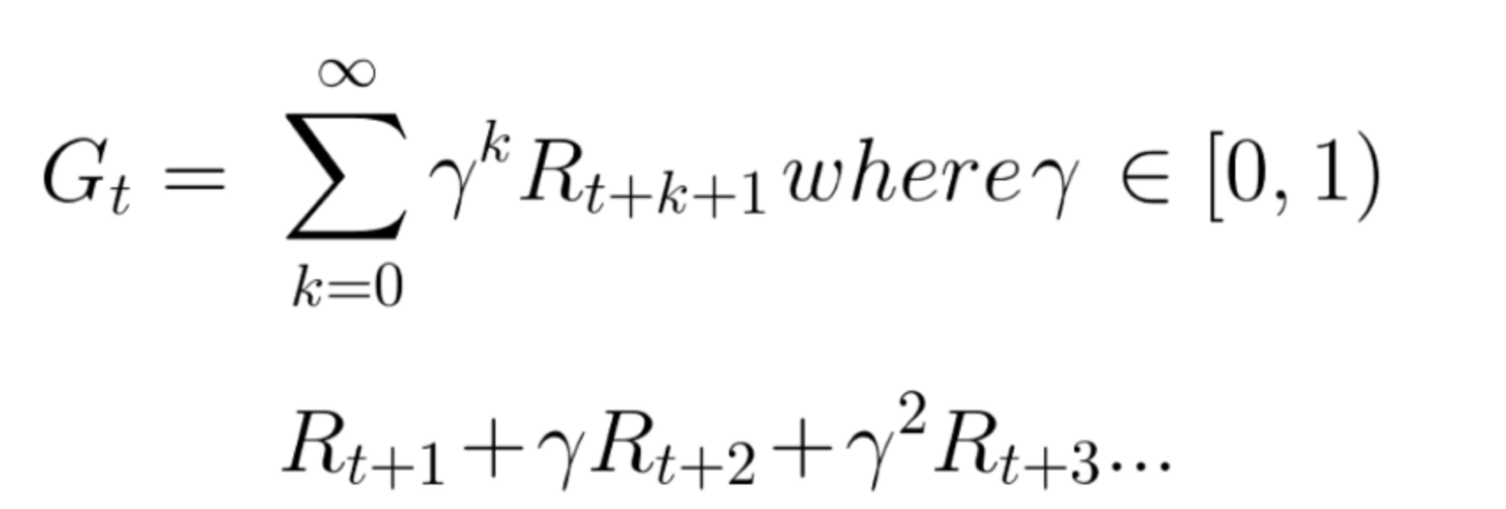
Reinforcement Learning Process
We Define a discount rate called gamma. It must be between 0 and 1
The larger gamma, the smaller discount. This means the learning agent cares more about the long term reward
On the other hand, the smaller the gamma, the bigger the discount. This means our agent cares more about the short term reward
To be simple, each reward will be discounted by gamma to the exponent of the time step. As the time step increases, the cat gets closer to us, so the future reward is less and less probable to happen

Slide 11
Basics of Machine Learning(Sub Module - 2)

Slide 12
Supervised Machine Learning
Supervised learning is when model gets trained on Labelled Dataset. Labelled Dataset is one which have both input and output parameters
Types of Supervised Machine Learning
Classification
Regression
Examples of Supervised Machine Learning Algorithms
Linear Regression
K-Nearest Neighbor
Gaussian Naive Bayes
Decision Tree
Support Vector Machine(SVM)
Random Forest

Slide 13
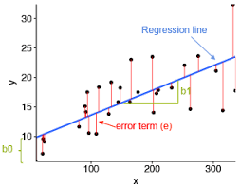
Linear Regression
A supervised learning algorithm that learns from set of training samples. It estimates relationship between a dependent variable(target/label) and one or more independent variable(predictors)

Slide 14
Objective of Linear Regression
Establish if there is a relationship between two variables
Examples: Relationship between housing prices and area of house, number of hours study and the marks obtained, income and spending and so on..
Prediction of New Possible Values
Based on the Area of house predicting the house price in a particular month, based on number of hours studied predicting the possible marks. Sales in next three months and so on.

Slide 15
Linear Regression Use Cases
Real Estate
To model residential home prices, as a function of the home’s living area, bathrooms, number of bedrooms, lot size.
Medicine
To analyze the effect of a proposed radiation treatment on reducing tumor sizes based on patient attributes such as age or weight
Demand Forecasting
To predict demand for goods and services. For Example, restaurant chains can predict the quantity of food depending on weather
Marketing
To Predict Company Sales based on previous month’s sales and stock price of a company

Slide 16
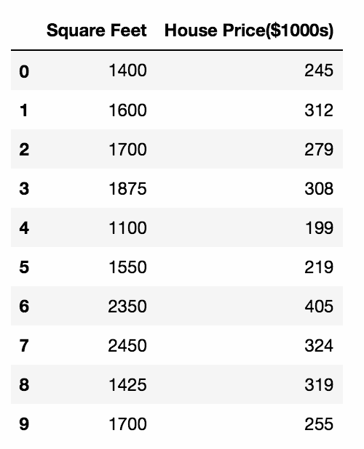
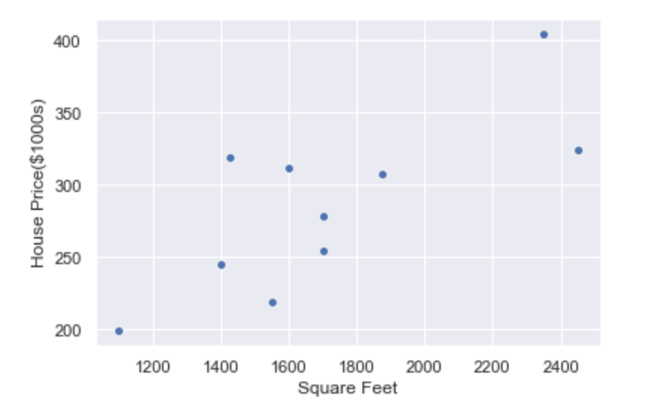
Housing Price Prediction
Consider you have a dataset containing of the area of several houses and their price. You wish to build a predictive model using the dataset that can predict the price of the house based on the area fed to it.

Slide 17
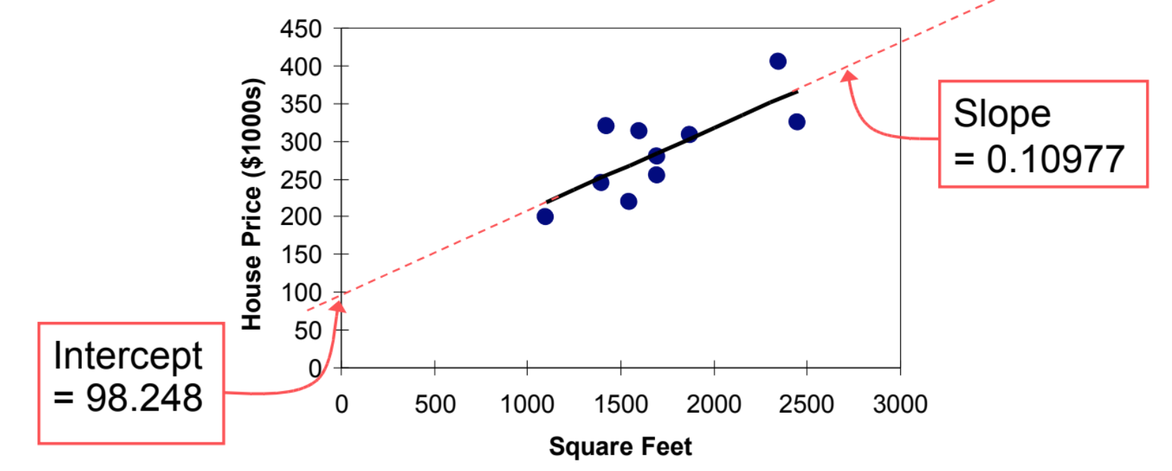
Housing Price Prediction
House_Price = 98.24 + 0.10977*(Square Feet)

Slide 18
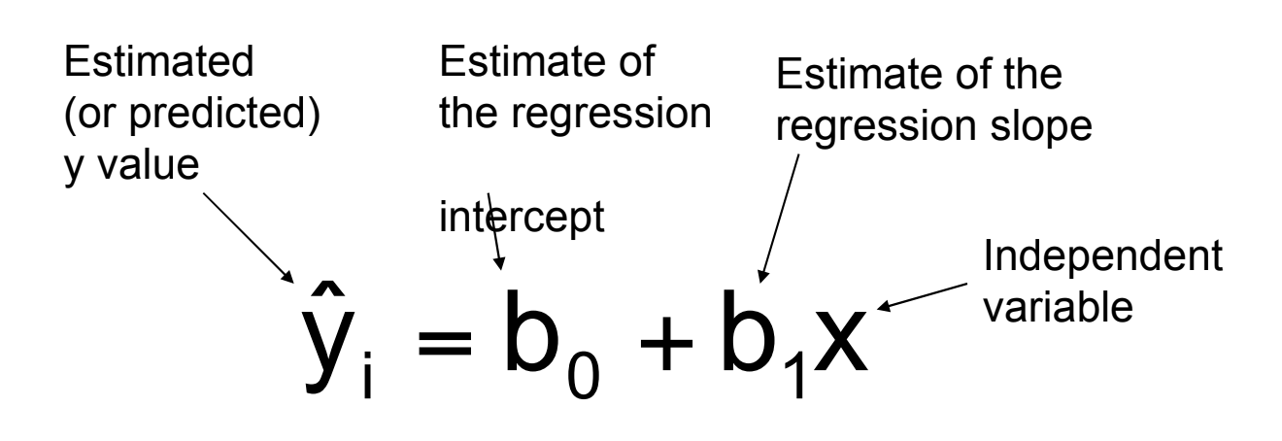
Plotting Graph
House_Price = 98.24 + 0.10977*(Square Feet)
‘ bo is the estimated value of y when x is zero’
Here no houses had 0 Square feet so b0 = 98.24, indicate that for the houses with in the range of size observed, $98,248.33 is the portion of the house price not explained by square feet

Slide 19
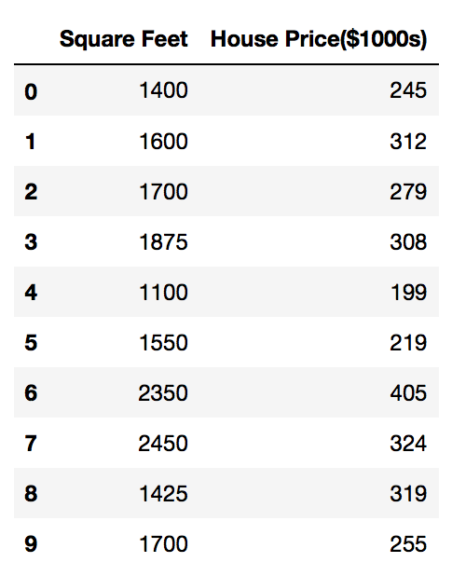
Predict the House Price
House_Price = 98.24 + 0.10977*(Square Feet)
Prediction for the House with 200 Square Feet
House_Price = 98.24 + 0.10977*200
= 317.85
The Predicted Value for the House with 2000 Square feet is 317.85($1.000s) = $317,850

Slide 20
Predict the House Price
House_Price = 98.24 + 0.10977*(Square Feet)
Prediction for the House with 200 Square Feet
House_Price = 98.24 + 0.10977*200
= 317.85
The Predicted Value for the House with 2000 Square feet is 317.85($1.000s) = $317,850

Slide 21
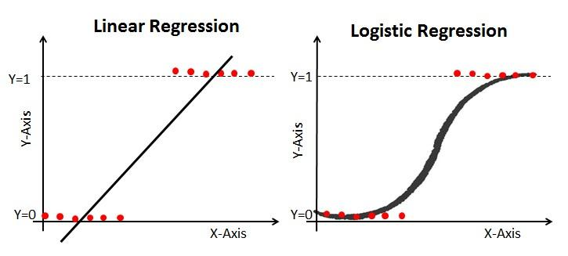
What is Logistic Regression
Logistic regression is a type of regression we use for response variable(Y) that following Binomial Distribution
It Estimates a relationship between a dependent variable (target/label) and one or more independent variable(predictors) where de

Slide 22
Types of Logistic Regression
Binary Logistic Regression: There are only two possible outcomes, such as Yes or No, Spam or no Spam. These are the outcomes of the Target Variable
Multinomial Logistic Regression: The Target Variable has three or more nominal categories and that to without ordering, such as predicting which superstar is more preferred, which is more preferred, predicting the type of wine.
Ordinal Logistic Regression: The target variable has three or more ordinal categories, it means the categories are in order. For Ex: Rating any Product, Restaurant, movie from 1 to 5

Slide 23
Example: Probability of Passing an Exam vs Hours of Study
A group of 20 students spend between 0 and 6 hours studying for an exam. How does the number of hours spent studying affect the probability that the student will pass the exam?

Slide 24
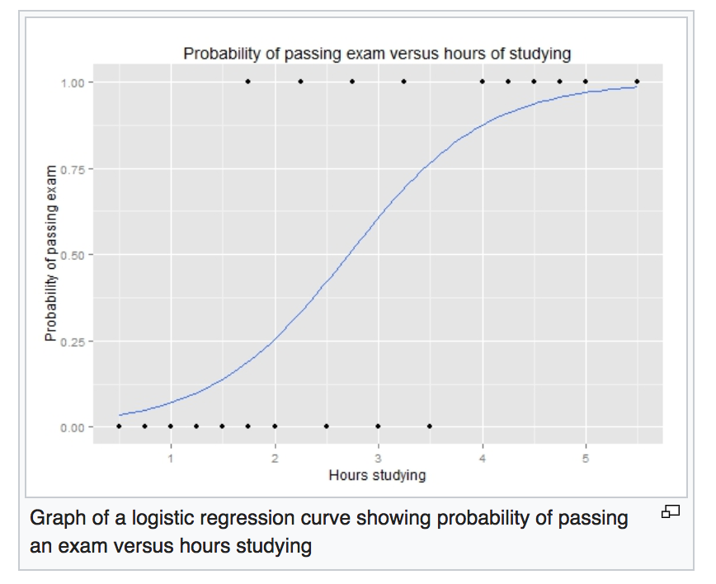
Example: Probability of Passing an Exam vs Hours of Study
The graph shows the probability of
passing the exam versus
the number of hours studying,
with the logistic regression
curve fitted to the data.

Slide 25
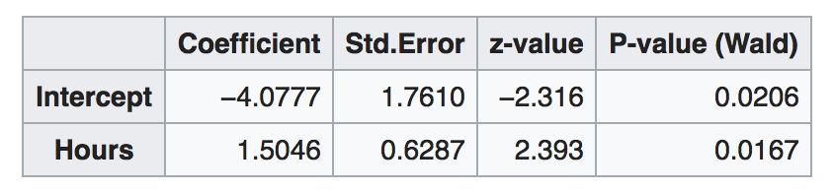
The Output of the Logistic Regression Analysis
One additional hour of study is estimated to increase log-odds of passing by 1.5046

Slide 26
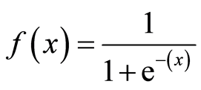
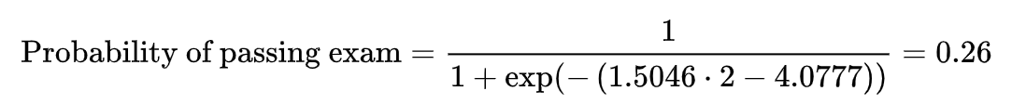
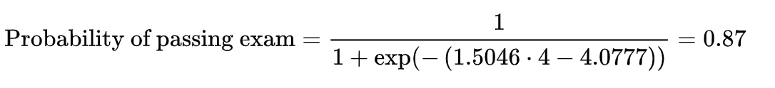
The Output of the Logistic Regression Analysis(Continued)
For Students who studies 2, 4 hours, Entering the value in the equation gives the estimated probability
of passing the exam of 0.26 and 0.87

Slide 27
PERFORMANCE MEASURES

Slide 28
Regression
RMSE (Root Mean Square Error)
Classification
Confusion Matrix
Precision and Recall
Area Under the Curve(AUC)
ROC Curve

Slide 29
Root Mean Square Error - Regression
This is a measure that’s often used to judge the quality of prediction
-Predicted value of X
- Actual value of y
For Each pair of value, do
-(y - X)^2
Procedure
-Sum over all pairs
-Divide the number of values get average
-take the square root of that
We use the Square because
-That always gives us a positive number

Slide 30
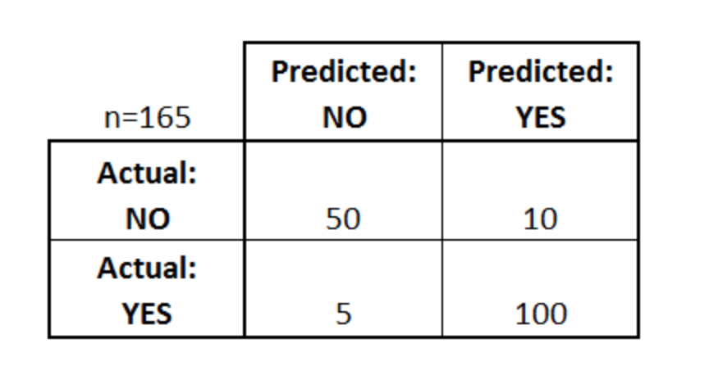
Confusion Matrix
A confusion matrix is a table that is often used to describe the performance of a classification model (or "classifier") on a set of test data for which the true values are known.
The classifier made a total of 165 predictions (e.g., 165 patients were being tested for the presence of that disease).
Out of those 165 cases, the classifier predicted "yes" 110 times, and "no" 55 times.
In reality, 105 patients in the sample have the disease, and 60 patients do not.

Slide 31
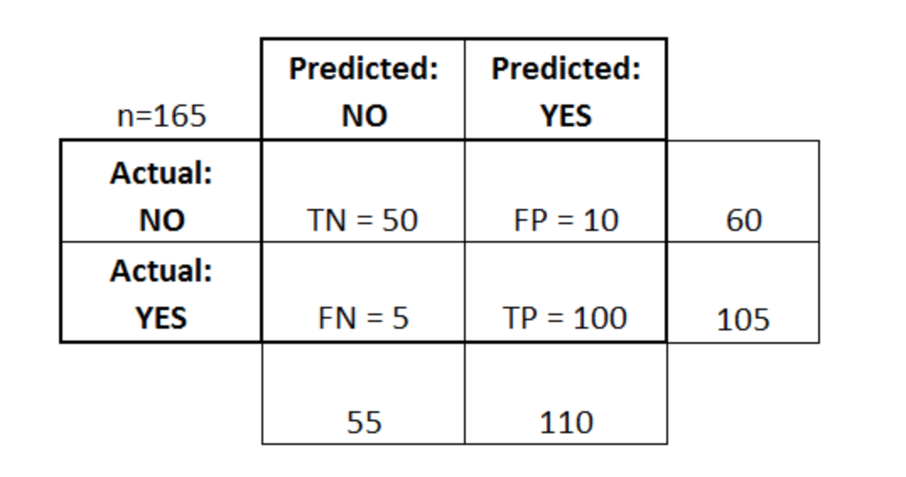
Confusion Matrix
true positives (TP): These are cases in which we predicted yes (they have the disease), and they do have the disease.
true negatives (TN): We predicted no, and they don't have the disease.
false positives (FP): We predicted yes, but they don't actually have the disease. (Also known as a "Type I error.")
false negatives (FN): We predicted no, but they actually do have the disease. (Also known as a "Type II error.")

Slide 32
Precision and Recall
Accuracy: Overall, how often is the classifier correct?
(TP+TN)/total = (100+50)/165 = 0.91
Misclassification Rate: Overall, how often is it wrong?
(FP+FN)/total = (10+5)/165 = 0.09
equivalent to 1 minus Accuracy
also known as "Error Rate"
True Positive Rate(Recall): When it's actually yes, how often does it predict yes?
TP/actual yes = 100/105 = 0.95
also known as "Sensitivity" or "Recall"
False Positive Rate: When it's actually no, how often does it predict yes?
FP/actual no = 10/60 = 0.17
Precision: When it predicts yes, how often is it correct?
TP/predicted yes = 100/110 = 0.91
F Score: This is a weighted average of the true positive rate (recall) and precision

Slide 33
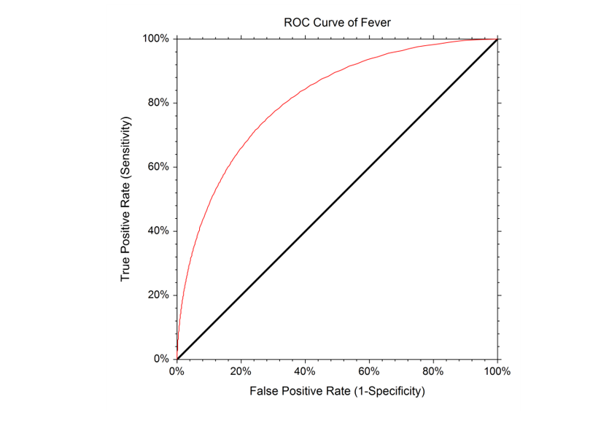
ROC Curve - Area Under the Curve
An ROC curve is a commonly used way to visualize the performance of a binary classifier, meaning a classifier with two possible output classes.
TPR vs FPR
Sensitivity vs 1 - Specificity
P(true|true) vs. P(true|false)
ROC Area: – 1.0: perfect prediction
– 0.9: excellent prediction
– 0.8: good prediction
– 0.7: mediocre prediction
– 0.6: poor prediction – 0.5: random prediction
– <0.5: something wrong!

Slide 34
KNN - K Nearest Neighbor Algorithm

Slide 35
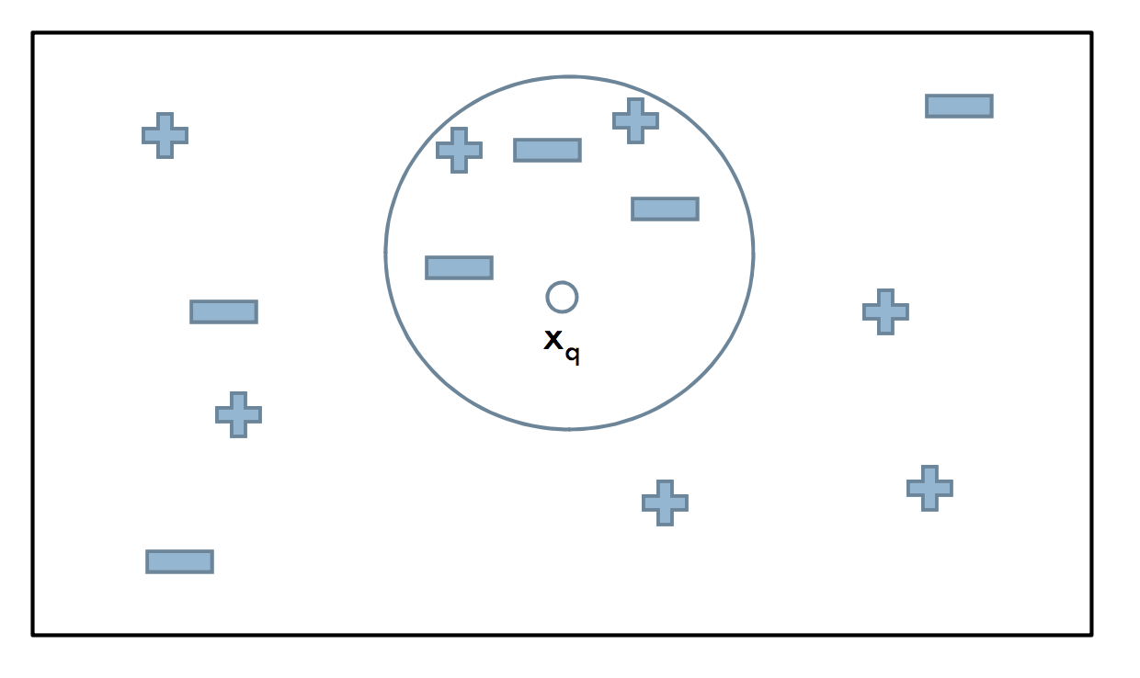
K Nearest Neighbor
Lazy Learning Algorithm
Defer the decision to generalize beyond the training examples till a new query is encountered
Whenever we have a new point to classify, classify, we find its K nearest neighbors from the training data
KNN can be used for both classification and regression predictive problems. However, it is more widely used in classification problems in the industry

Slide 36
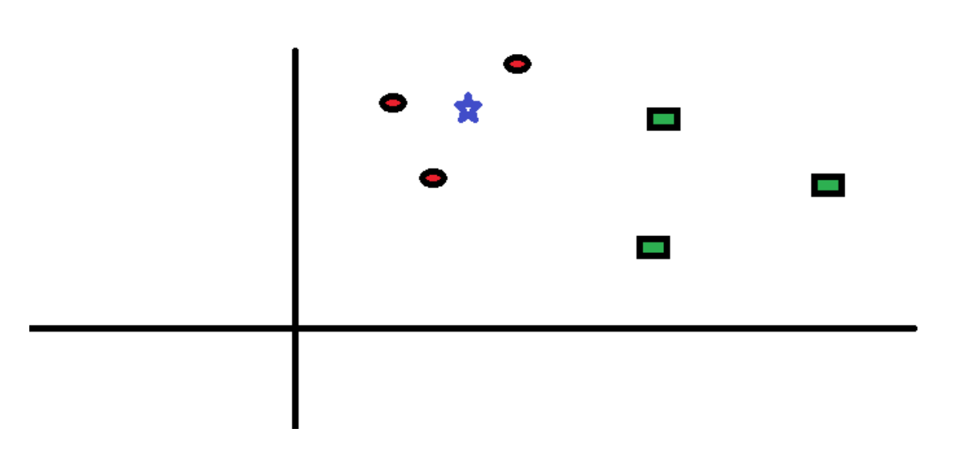
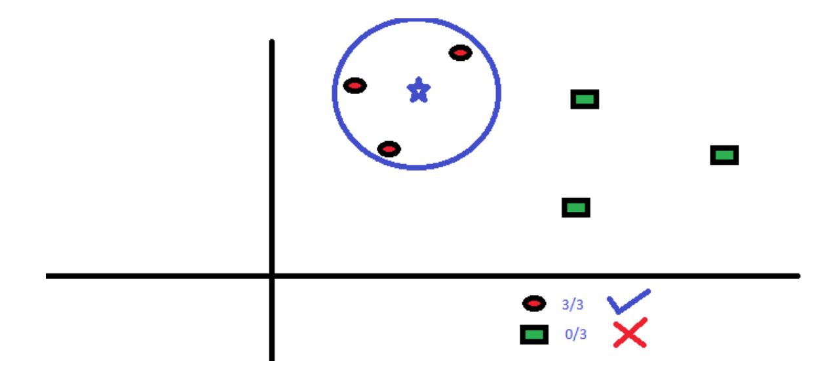
How Does KNN Algorithm Works
Let’s take a simple case to understand this algorithm. Following is a spread of red circles (RC) and green squares (GS) :
You intend to find out the class of the blue star (BS) . BS can either be RC or GS and nothing else. The “K” is KNN algorithm is the nearest neighbors we wish to take vote from. Let’s say K = 3. Hence, we will now make a circle with BS as center just as big as to enclose only three data points on the plane

Slide 37
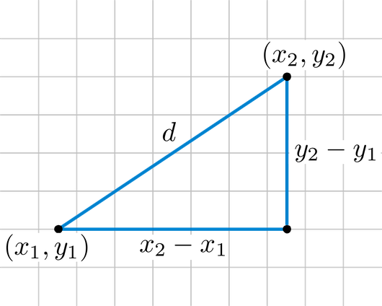
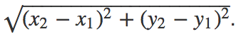
Euclidean Distance
Squared distance between two vectors [ x1 y1 ] and [ x2 y2 ] is the sum of squared differences in their coordinates
To denote the distance between vectors x and y we can use the notation dx,y so that this last result can be written as
d = (x2 – x1) 2 + (y2 – y1) 2
That is the distance itself is a square root of

Slide 38
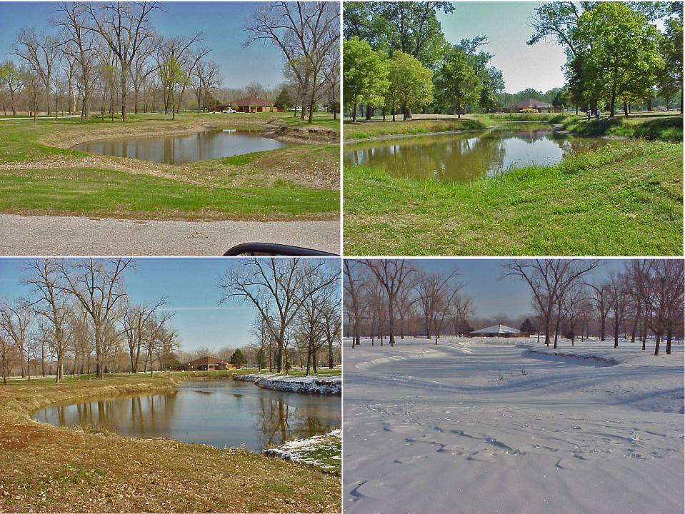
Euclidean Distance
Relationships between water status, leaf chlorophyll content and photosynthetic performance

Slide 39
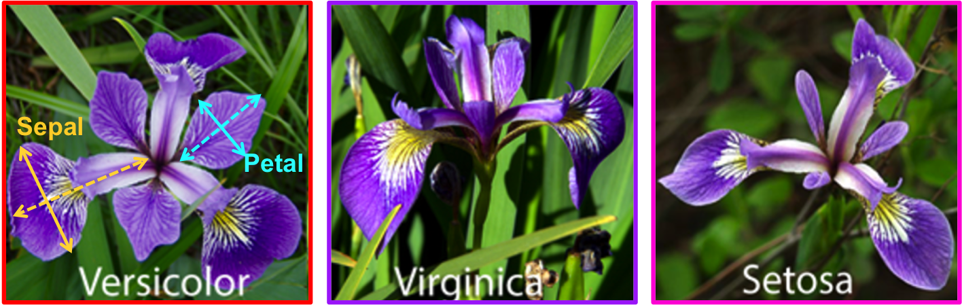
Irish Flower Classification
The aim is to classify iris flowers among three species (setosa, versicolor or virginica) from measurements of length and width of sepals and petals.
The iris data set contains 3 classes of 50 instances each, where each class refers to a type of iris plant.
The central goal here is to design a model which makes good classifications for new flowers or, in other words, one which exhibits good generalization.

Slide 40
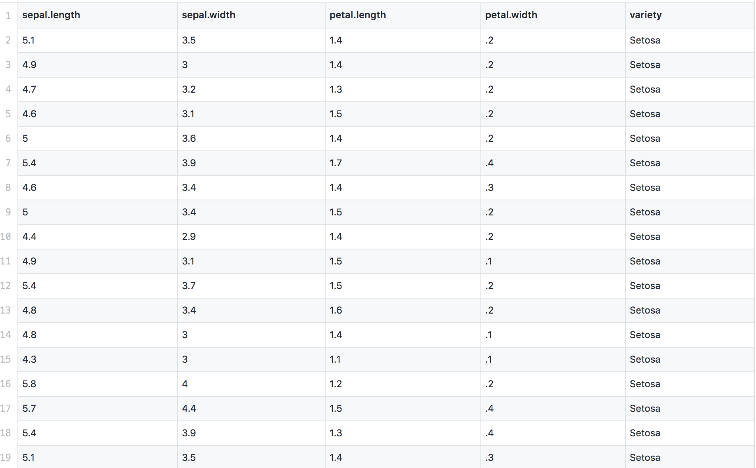
Irish Flower Classification
iris.csv

Slide 41
Load Dataset
from sklearn import datasets
import numpy as np
import random
import matplotlib.pyplot as plt
iris = datasets.load_iris()
predictors = iris.data[:, 0:2]
outcomes = iris.target

Slide 42
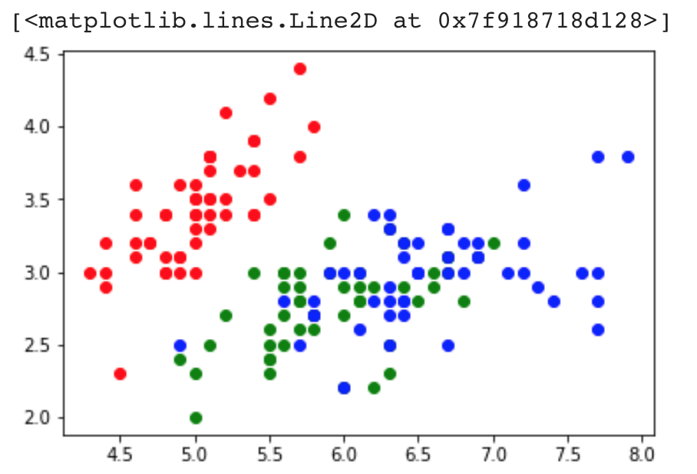
Visualize
plt.plot(predictors[outcomes == 0][:, 0], predictors[outcomes == 0][:, 1], "ro")
plt.plot(predictors[outcomes == 1][:, 0], predictors[outcomes == 1][:, 1], "go")
plt.plot(predictors[outcomes == 2][:, 0], predictors[outcomes == 2][:, 1], "bo")

Slide 43
KNN Classifier
from sklearn.neighbors import KNeighborsClassifier #predictions from skikit
knn = KNeighborsClassifier(n_neighbors = 5)
knn.fit(predictors, outcomes)
sk_predictions = knn.predict(predictors)
predict = zip(sk_predictions, outcomes)
for pred_, true_ in predict:
print(pred_, true_)

Slide 44
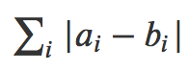
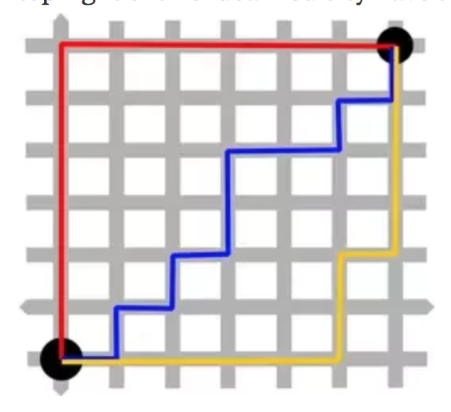
Manhattan Distance
The Manhattan distance between two vectors (or points) a and b defined as
This is known as Manhattan distance because all paths from
the bottom left to top right of this idealized city have the same distance:

Slide 45
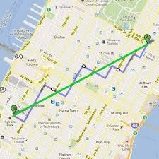
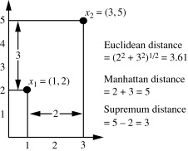
Manhattan Distance
In 2 dimensional plane: It simply is the sum of horizontal and vertical distance between two points,let us consider it between point A(x1,y1) and B(x2,y2)
𝑀𝑎𝑛ℎ𝑎𝑡𝑡𝑎𝑛𝑑𝑖𝑠𝑡𝑎𝑛𝑐𝑒=𝑎𝑏𝑠(𝑥1−𝑥2)+𝑎𝑏𝑠(𝑦1−𝑦2)

Slide 46
Limitation
The main disadvantage of the KNN algorithm is that it is a lazy learner,
it does not learn anything from the training data and simply uses the training data itself for classification
The main disadvantage of this approach is that the algorithm must compute the distance and sort all the training data at each prediction, which can be slow if there are a large number of training examples

Slide 47
SVM(Support Vector Machine)

Slide 48
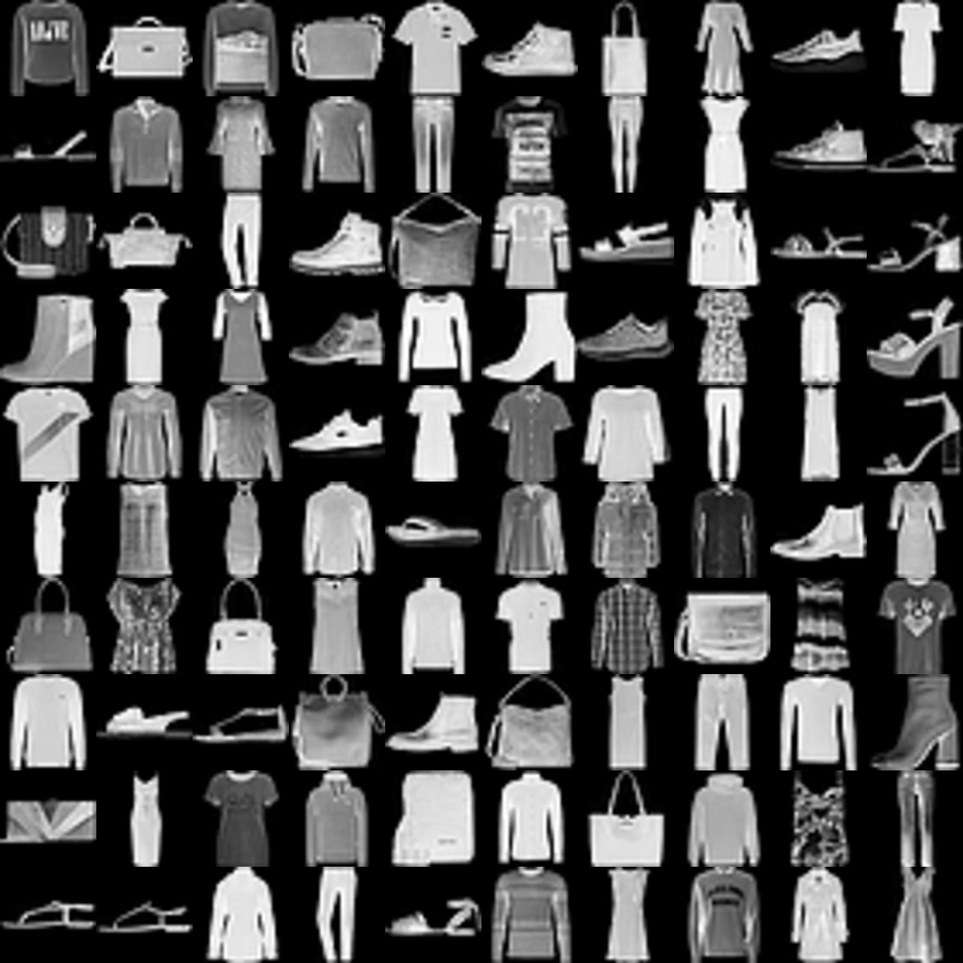
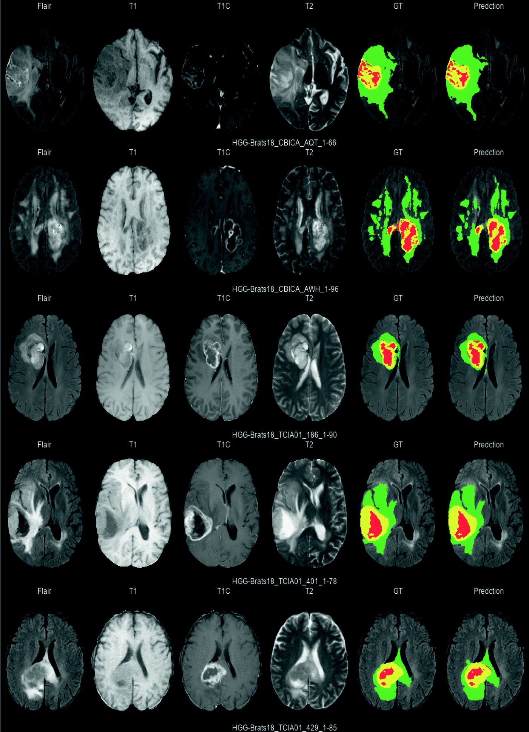
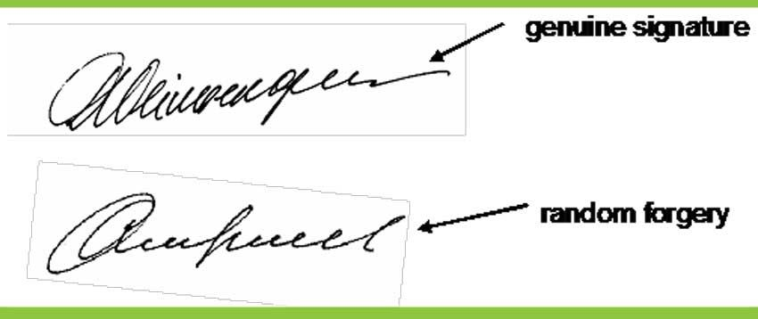
Non Linear Classification Challenge
It transforms non-linear data into linear data and then draws a hyperplane.

Slide 49
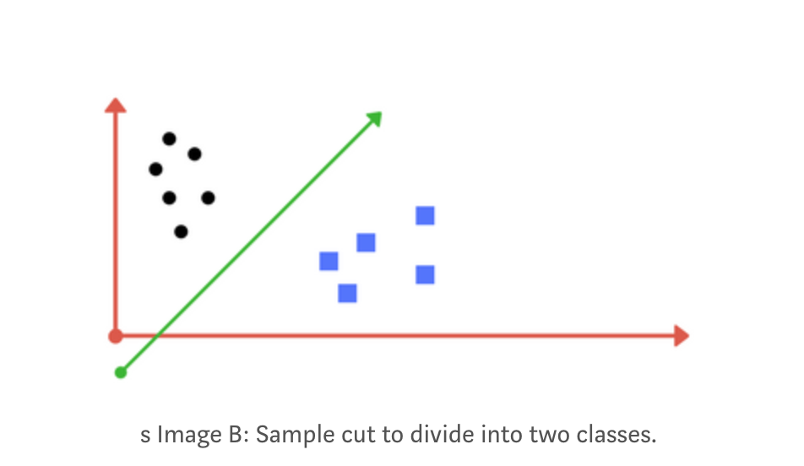
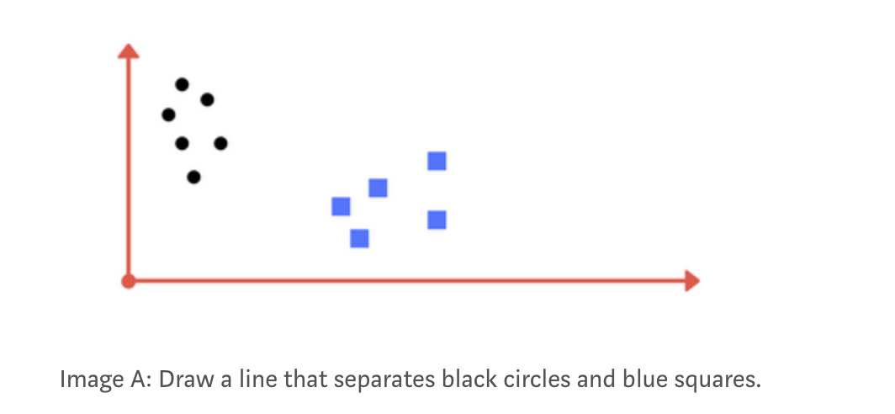
Introduction
It's a supervised machine learning algorithm which can be used for both classification or regression problems. But it's usually used for classification. Given 2 or more labeled classes of data, it acts as a discriminative classifier, formally defined by an optimal hyperplane that separates all the classes.

Slide 50
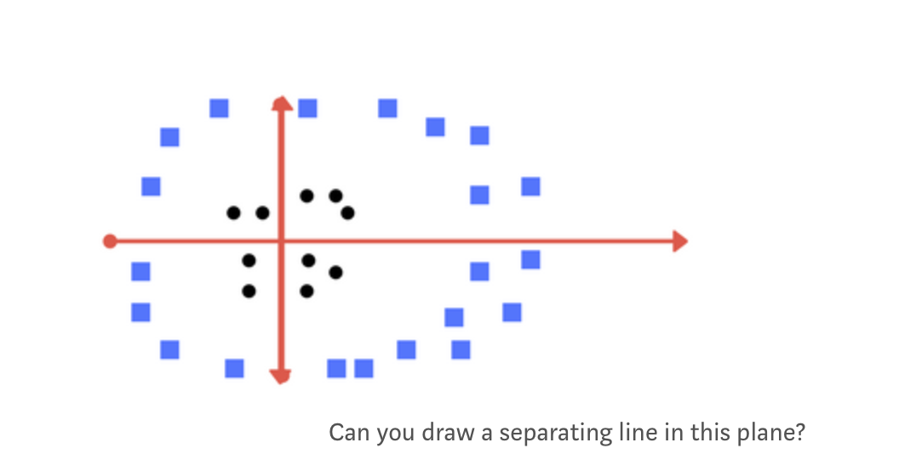
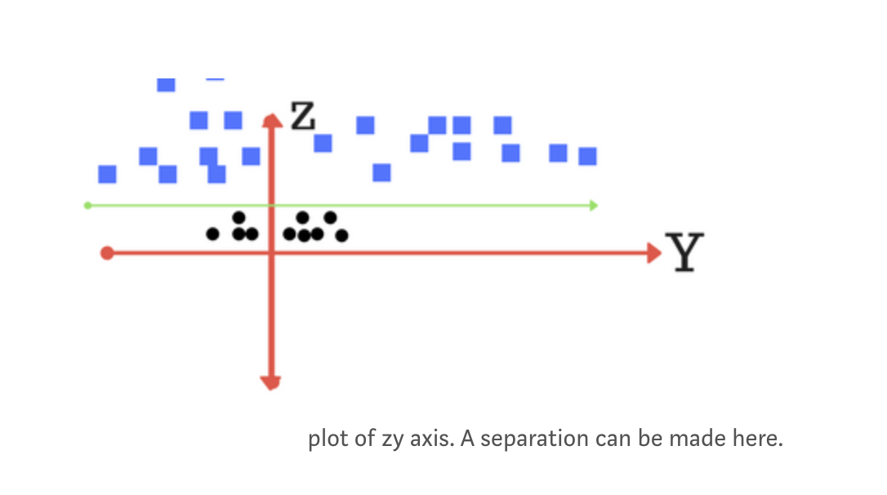
Kernel
We apply transformation and add one more dimension as we call it z-axis. Let’s assume value of points on z plane, w = x² + y². In this case we can manipulate it as distance of point from z-origin. Now if we plot in z-axis, a clear separation is visible and a line can be drawn

Slide 51
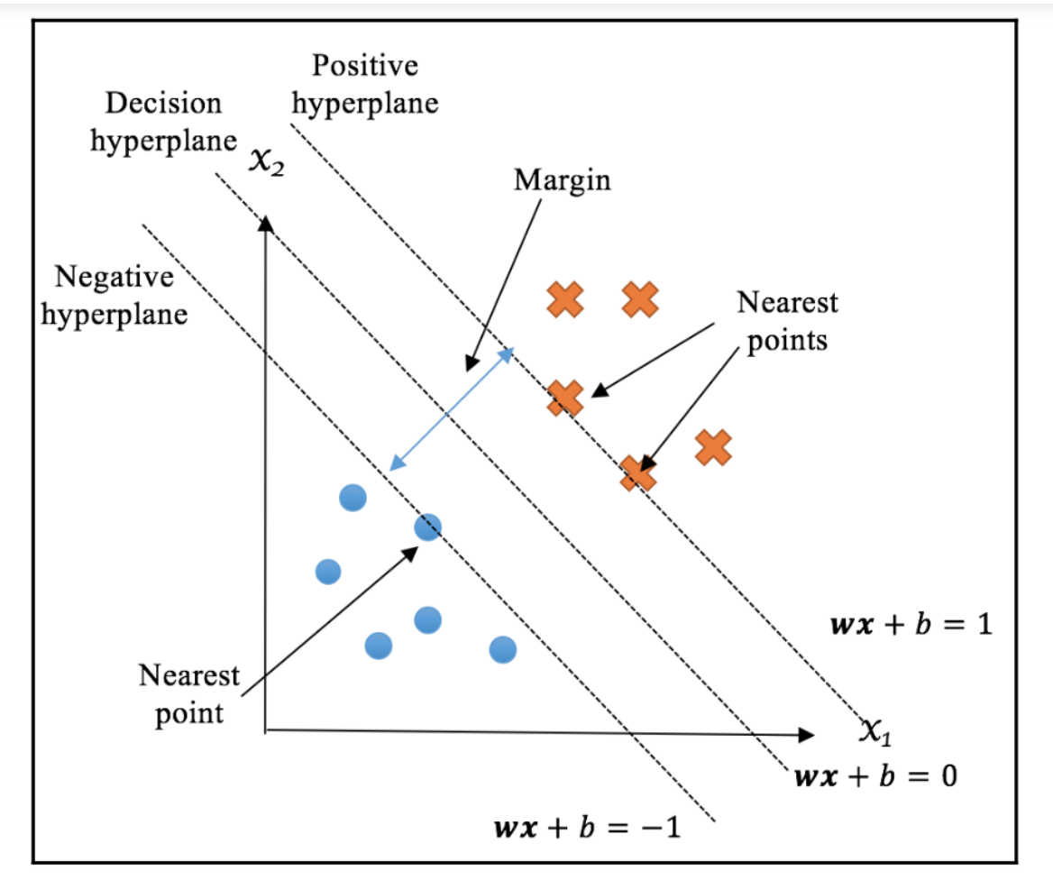
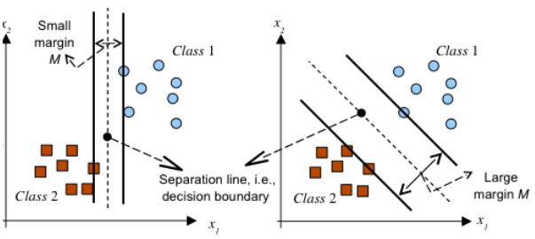
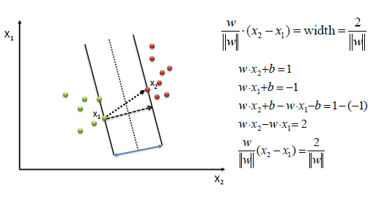
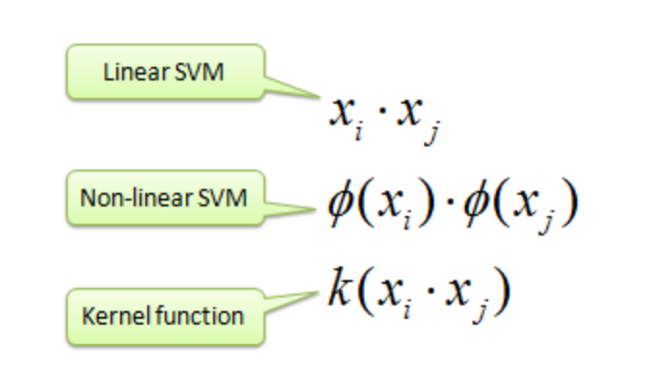
SVM Mechanism

Slide 52
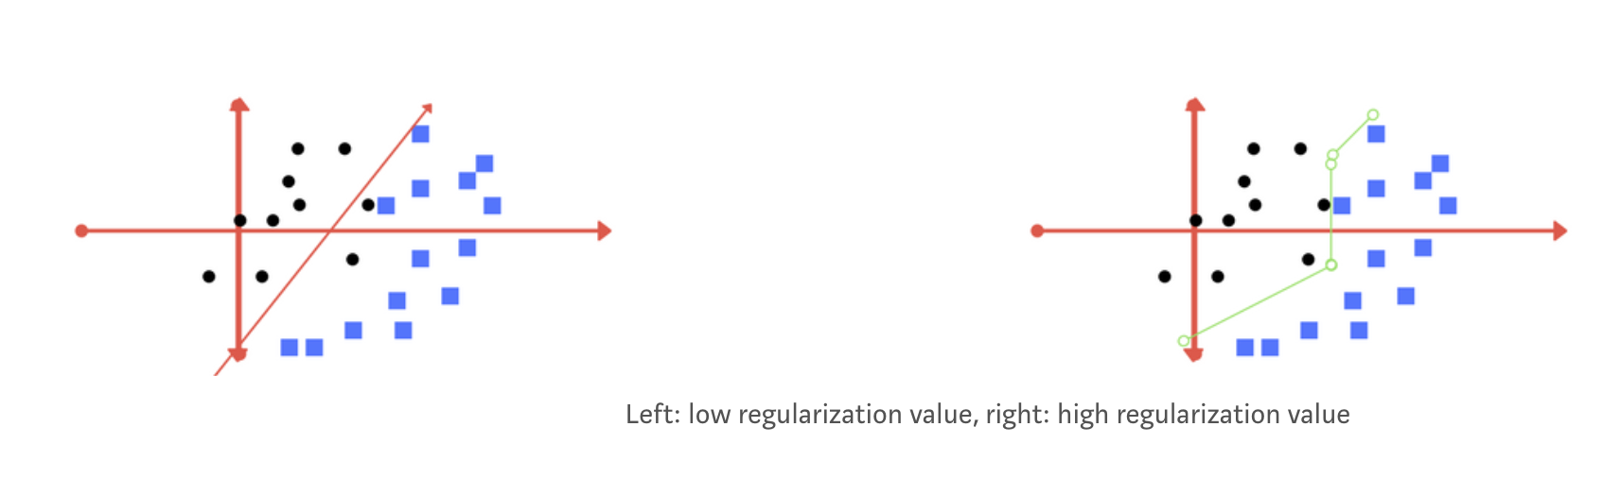
Regularization
The Regularization parameter (often termed as C parameter in python sklearn library) tells the SVM optimization how much you want to avoid misclassifying each training example
C-Value
For large values of C, the optimization will choose a smaller-margin hyperplane if that hyperplane does a better job of getting all the training points classified correctly. Conversely, a very small value of C will cause the optimizer to look for a larger-margin separating hyperplane, even if that hyperplane misclassified more points.

Slide 53
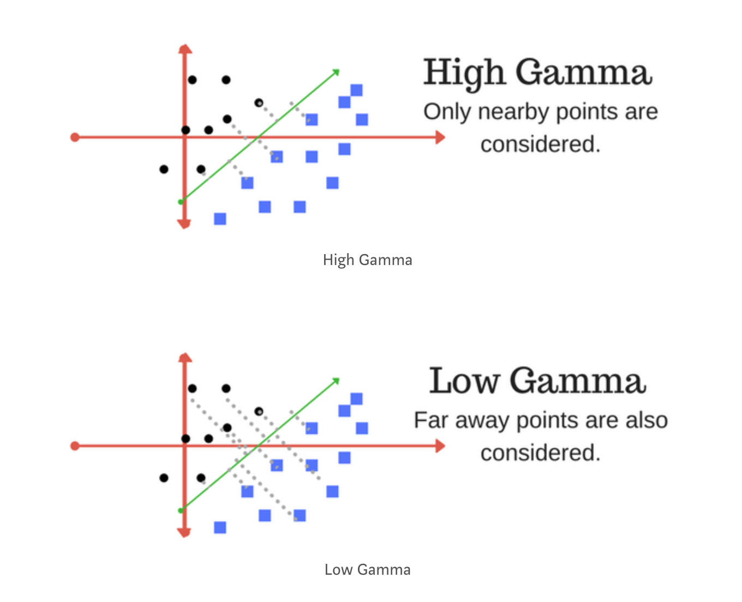
Regularization - Gamma value
The gamma parameter defines how far the influence of a single training example reaches, with low values meaning ‘far’ and high values meaning ‘close’. In other words, with low gamma, points far away from plausible separation line are considered in calculation for the separation line. Where as high gamma means the points close to plausible line are considered in calculation.

Slide 54
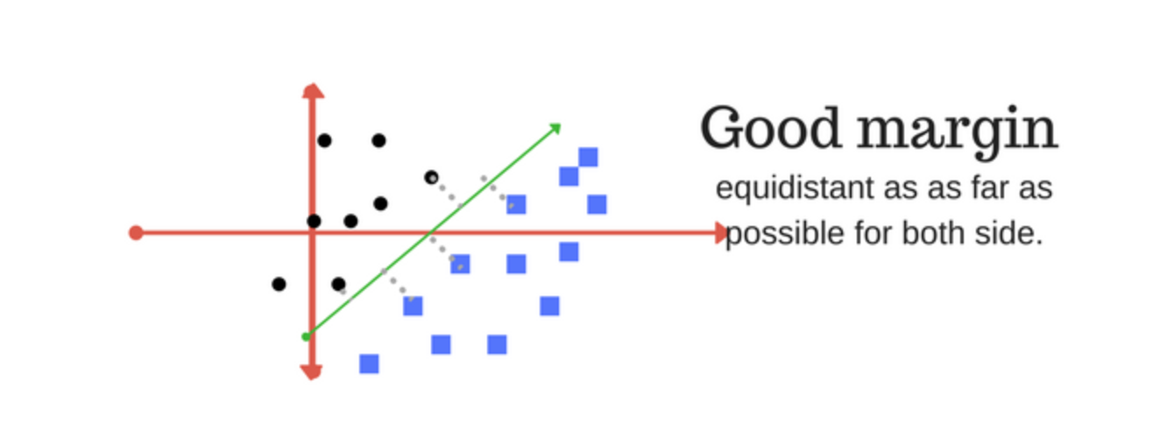
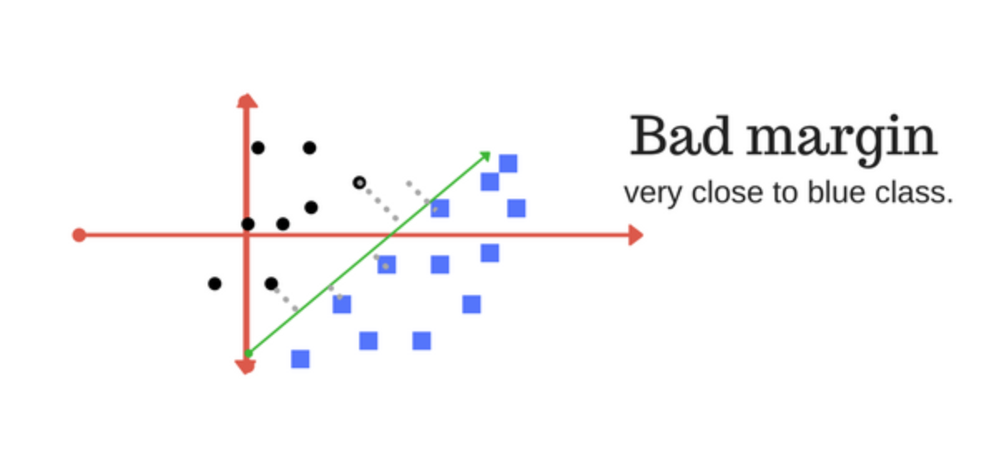
Margin
A margin is a separation of line to the closest class points.
A good margin is one where this separation is larger for both the classes. Images below gives to visual example of good and bad margin. A good margin allows the points to be in their respective classes without crossing to other class.

Slide 55
Decision Tree

Slide 56

Attribute-based representations
Examples described by attribute values (Boolean, discrete, continuous)
E.g., situations where I will/won't wait for a table:

Slide 57

Attribute-based representations
One possible representation for hypotheses
E.g., here is the “true” tree for deciding whether to wait

Slide 58

Choosing an attribute
Idea: a good attribute splits the examples into subsets that are (ideally) "all positive" or "all negative"
Patrons?is a better choice

Slide 59

Using information theory
To implement Choose-Attributein the DTL algorithm
Information Content (Entropy):
I(P(v₁), … , P(v_{n})) = Σ_{i=1}-P(v_{i}) log₂P(v_{i})
For a training set containing p positive examples and n negative examples:

Slide 60


Information Gain
A chosen attribute Adivides the training set Einto subsets E₁, … , E_{v}according to their values for A, where Ahas vdistinct values
Information Gain (IG) or reduction in entropy from the attribute test:

Slide 61
Information Gain
Information Gain (IG) or reduction in entropy from the attribute test:

Slide 62

Information Gain
A chosen attribute Adivides the training set Einto subsets E₁, … , E_{v}according to their values for A, where Ahas vdistinct values
Patronshas the highest IG of all attributes and so is chosen by the DTL algorithm as the root

Slide 63

Decision Tree

